Slide 1
3:1-7

Slide 2
3:1-7
1 Peter 3:1–7 ~ ¹ Wives, likewise, be submissive to your own husbands, that even if some do not obey the word, they, without a word, may be won by the conduct of their wives, ² when they observe your chaste conduct accompanied by fear. ³ Do not let your adornment be merely outward – arranging the hair, wearing gold, or putting on fine apparel – ⁴ rather let it be the hidden person of the heart, with the incorruptible beauty of a gentle and quiet spirit, which is very precious in the sight of God. ⁵ For in this manner, in former times,

Slide 3
3:1-7
1 Peter 3:1–7 ~ the holy women who trusted in God also adorned themselves, being submissive to their own husbands, ⁶ as Sarah obeyed Abraham, calling him lord, whose daughters you are if you do good and are not afraid with any terror.
⁷ Husbands, likewise, dwell with them with understanding, giving honor to the wife, as to the weaker vessel, and as being heirs together of the grace of life, that your prayers may not be hindered.

Slide 4
KJV, NIV ~ strangers
3:1-7
This Photo by Unknown Author is licensed under CC BY-SA
This Photo by Unknown Author is licensed under CC BY-SA-NC

Slide 5
3:1-7

Slide 6
KJV, NIV ~ strangers
3:1-7
Marriage rates
2,000,000
1,500,000
1,000,000
Divorce rates
500,000
1970
1980
1990
2000
2010

Slide 7
3:1-7

Slide 8
3:1-7
likewise ~ homoiōs
NIV, NASB ~ in the same way

Slide 9
3:1-7

Slide 10
3:1-7
1 Peter 2:21-24 ~ ²¹ For to this you were called, because Christ also suffered for us, leaving us an example, that you should follow His steps:
²² “Who committed no sin,
Nor was deceit found in His mouth”;
²³ who, when He was reviled, did not revile in return; when He suffered, He did not threaten, but committed Himself to Him who judges righteously; ²⁴ who Himself bore our sins in His own body on the tree, that we, having died to sins, might live for righteousness – by whose stripes you were healed.

Slide 11
3:1-7
submissive ~ “a voluntary selflessness”

Slide 12
3:1-7

Slide 13
3:1-7
1 Pet. 1:15 ~ hagios – to be set apart
chaste ~ hagnos – “set apart” for her man
conduct ~ KJV, conversation
fear ~ phobos – same as Eph. 5:33 (let the wife see that she respects her husband.)

Slide 14
3:1-7

Slide 15
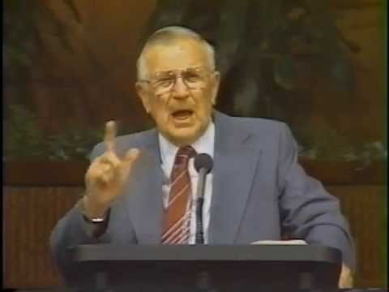
3:1-7
If the barn needs paintin’ – then, paint it.
fine apparel
NIV ~ fine clothes
KJV ~ apparel
NASB ~ dresses
J. Vernon McGee
(1904-1988)

Slide 16
3:1-7

Slide 17
3:1-7
Gen. 18:12 – Therefore Sarah laughed within herself, saying, “After I have grown old, shall I have pleasure, my lord being old also?”
NIV ~ called him her master
Living Bible ~ honoring him as the head of the house
Message ~ would address him as “my dear husband”

Slide 18
3:1-7

Slide 19
3:1-7
Gen 2:18 ~ And the LORD God said, “It is not good that man should be alone; I will make him a helper comparable to him.”
helper ~ ‘ezer – helper
comparable ~ neged – counterpart
“A complementing partner”

Slide 20
3:1-7
Eccl. 4:12b ~ a three-fold cord is not
easily broken.
Jesus Christ

Slide 21
3:1-7

Slide 22
3:1-7
Eph 5: 25 ~ Husbands, love your wives, just as Christ also loved the church and gave Himself for her,

Slide 23
3:1-7

Slide 24
3:1-7
2x World Light Heavyweight champion
22 wins/1 loss/ 1 disqualification
9 KOs
6 submissions
6’ 4”, 205 lb.
Jon Jones

Slide 25
3:1-7

